Slide 1
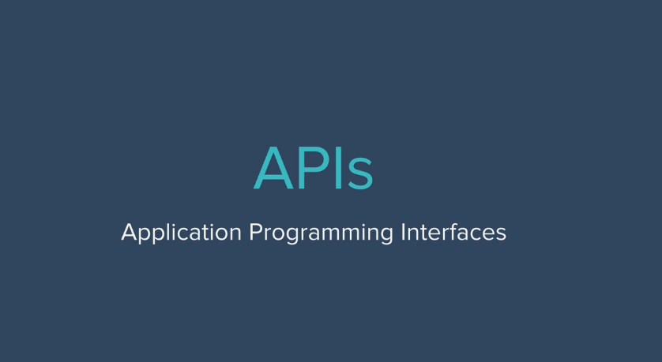

Slide 2
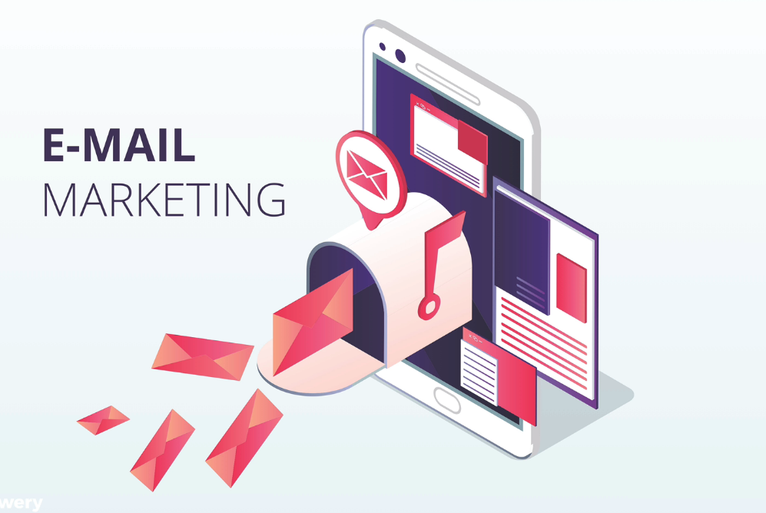

Slide 3
If we visit web sites like yahoo
and news web sites, we may see whether
report at home page.
So where we get these data service?

Slide 4
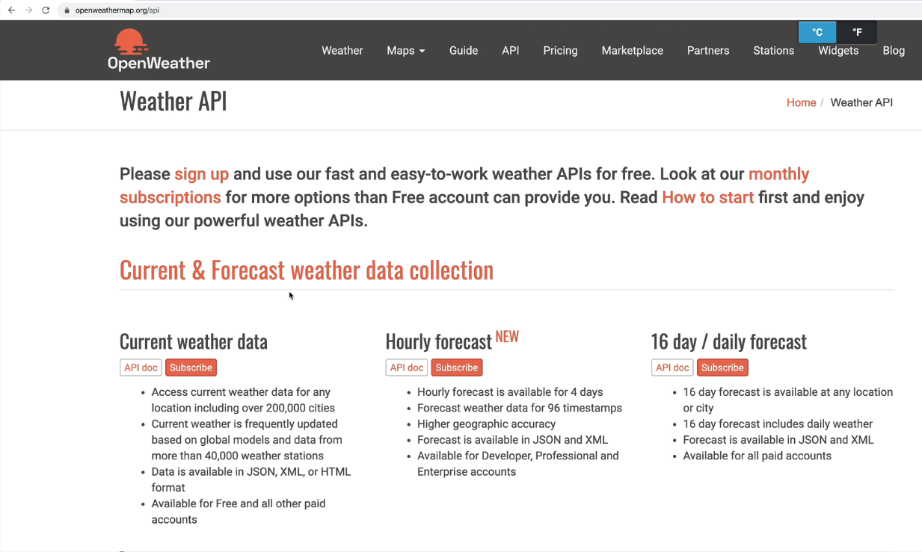

Slide 5
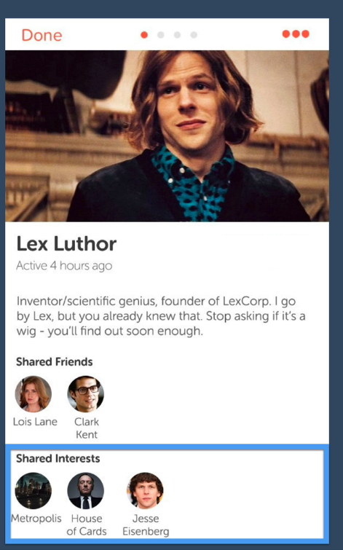
Here some piece of information
Received from facebook API

Slide 6
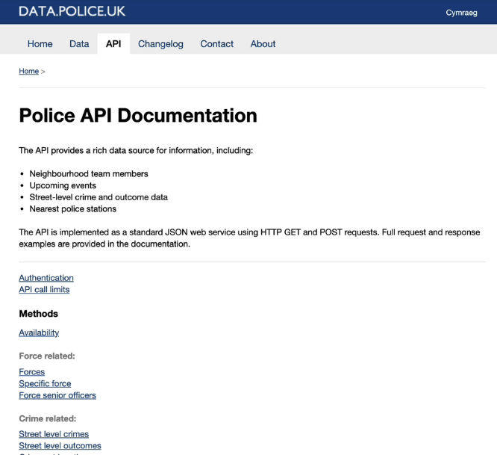

Slide 7
With the help of API , we can build some
Useful websites.
We can access all sorts of data via APIs and use them
To create our own web sites.

Slide 8
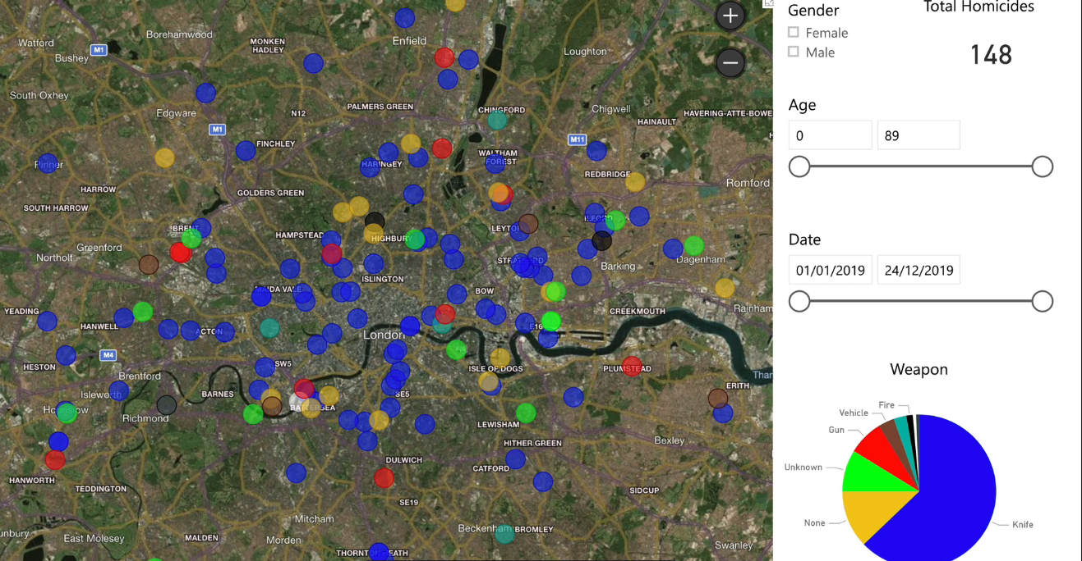

Slide 9
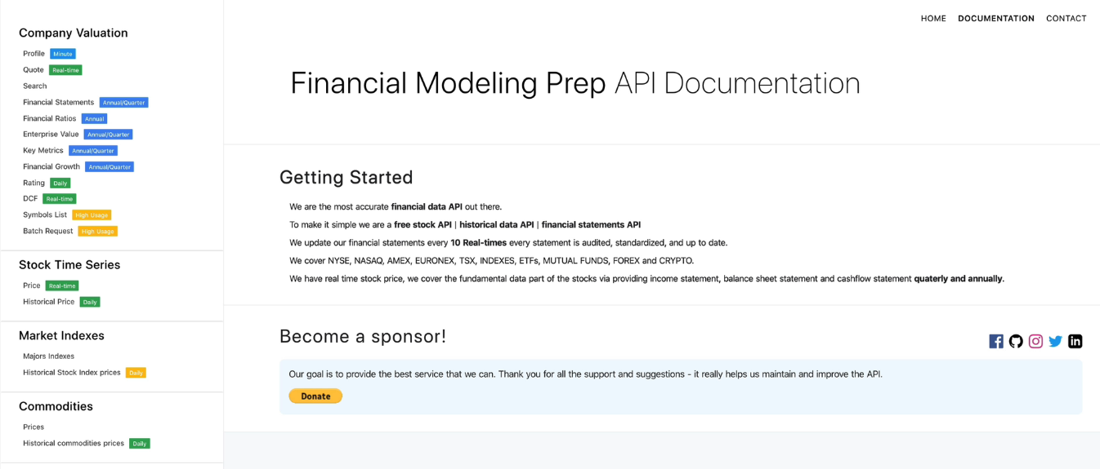
Payment API

Slide 10
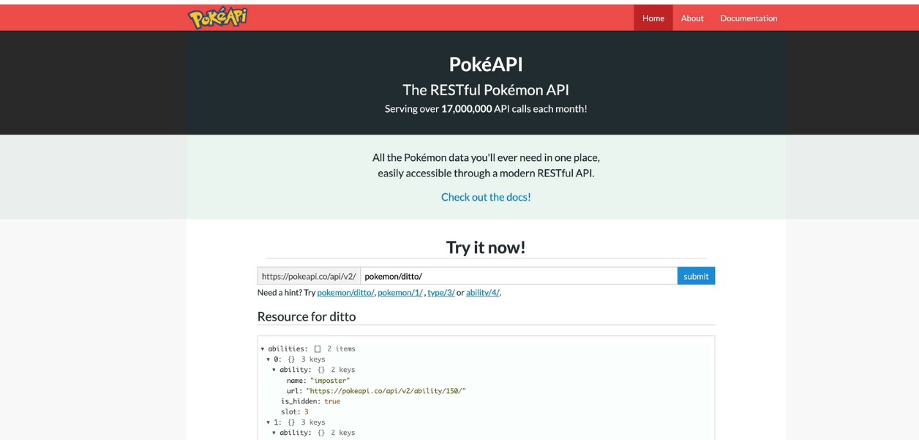

Slide 11
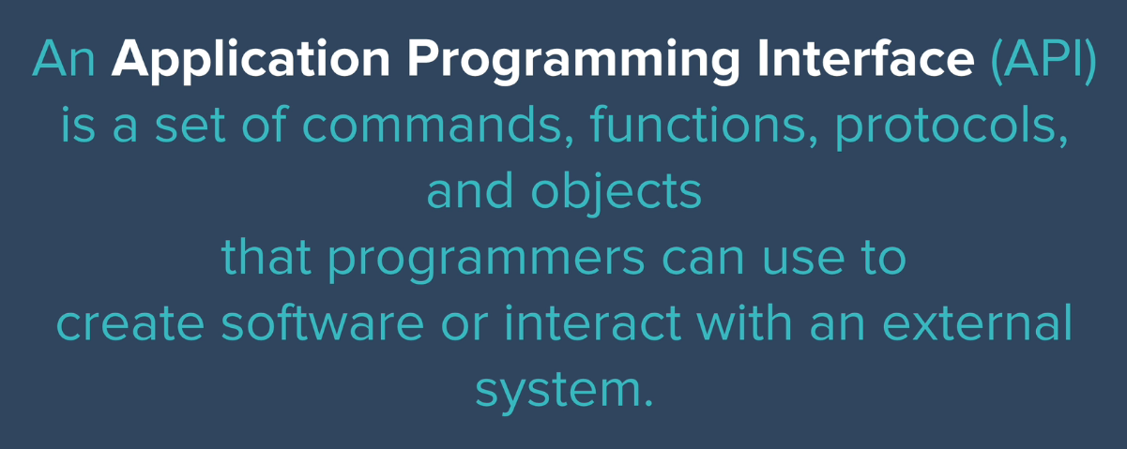

Slide 12

Here some example to understand
About API

Slide 13
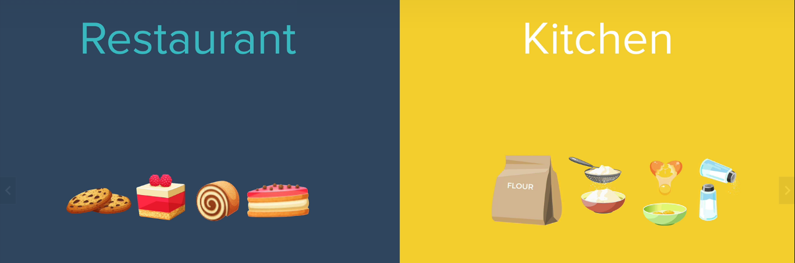
Here some example to understand
About API

Slide 14
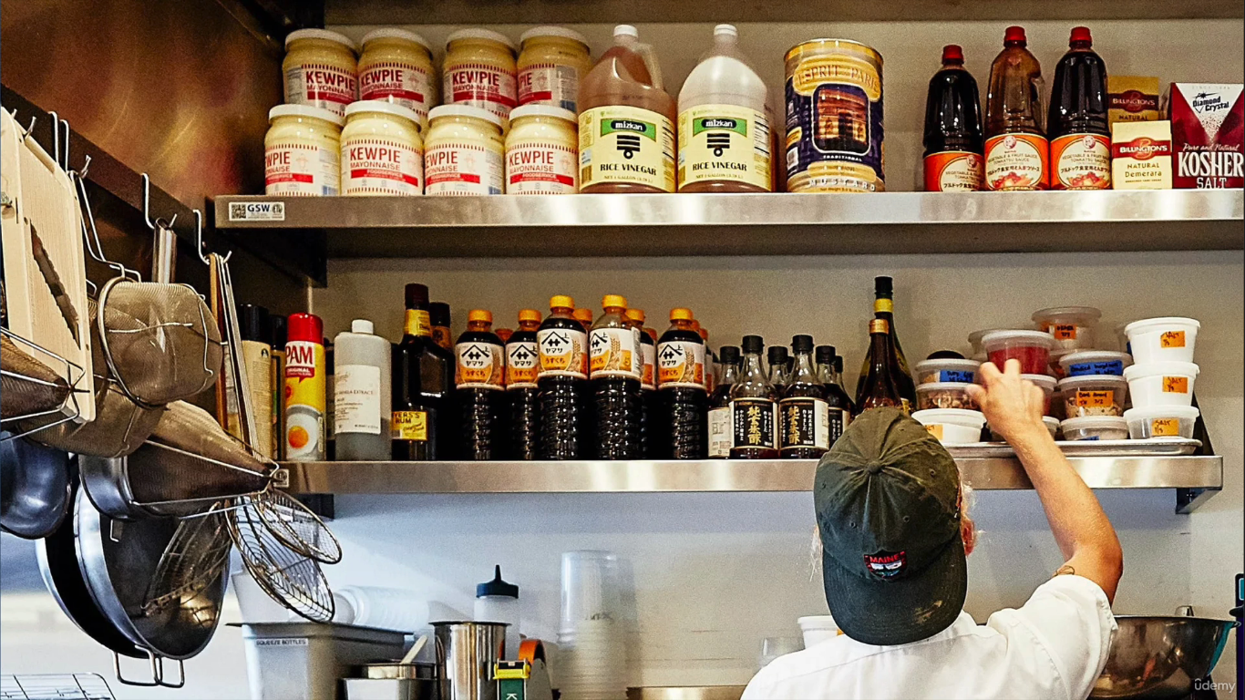
We can not go directly and access kitchen in restaurant

Slide 15
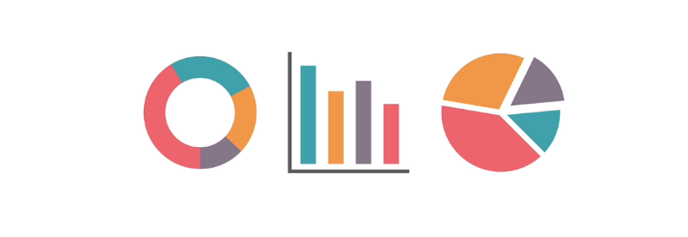
The same way in internet , we can not
Allow to take data directly.

Slide 16
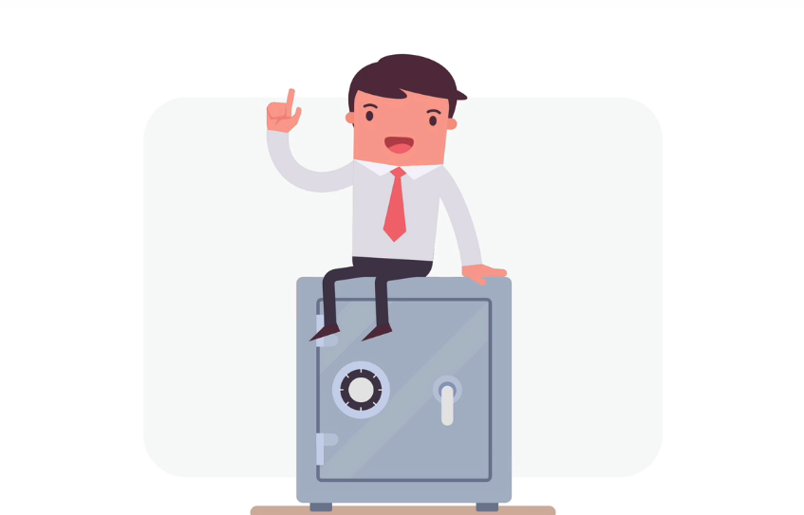
Security
Features will not
Allow us to use
Important
Data
In
Internet.

Slide 17
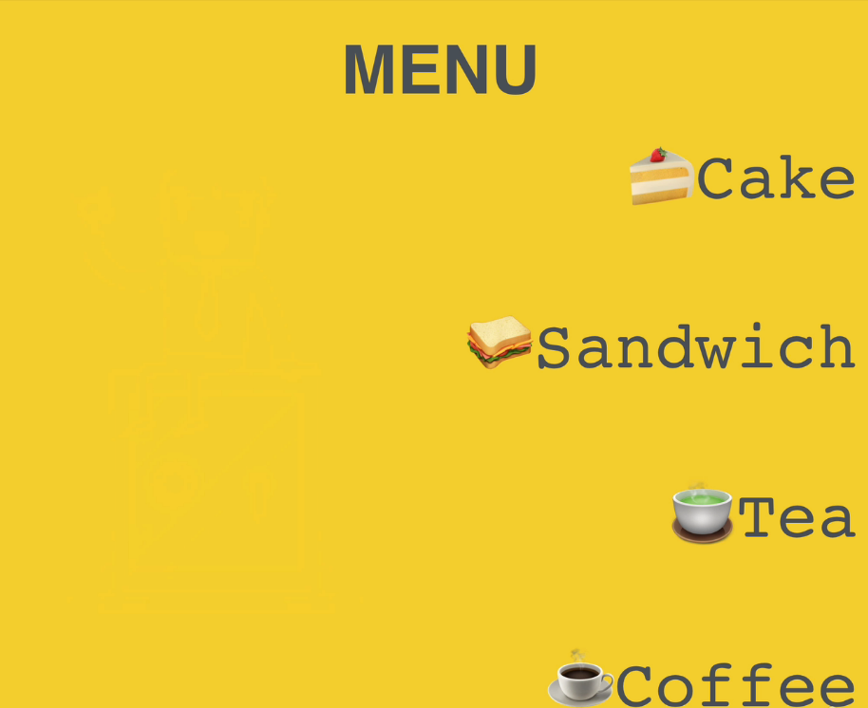
In Hotel,
There is a
Menu which provides
Data – These data
Can be given as
service

Slide 18
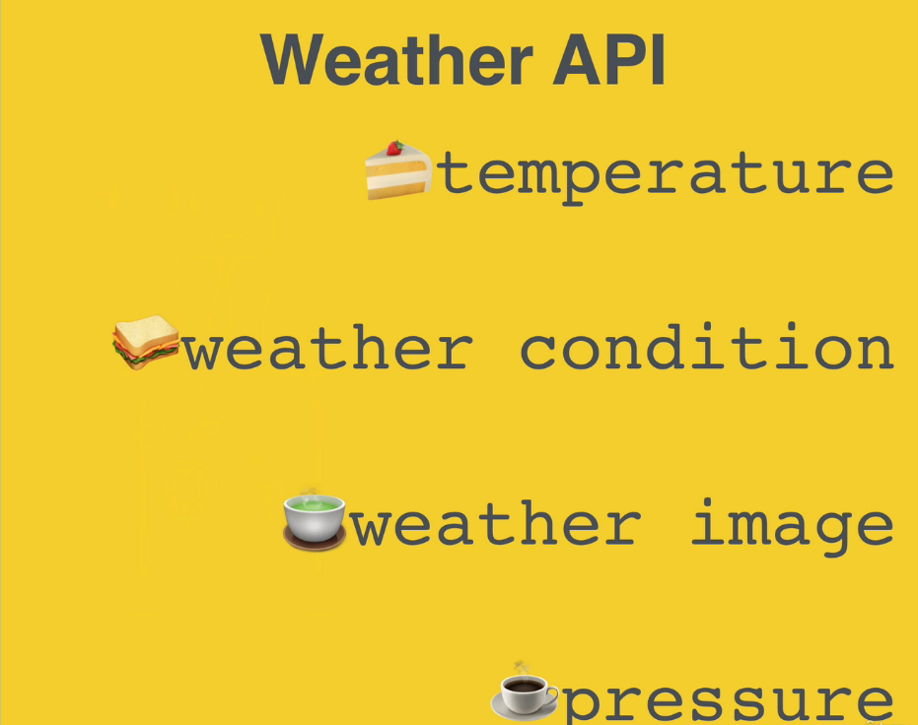
In whether API,
Some services
are provided.

Slide 19
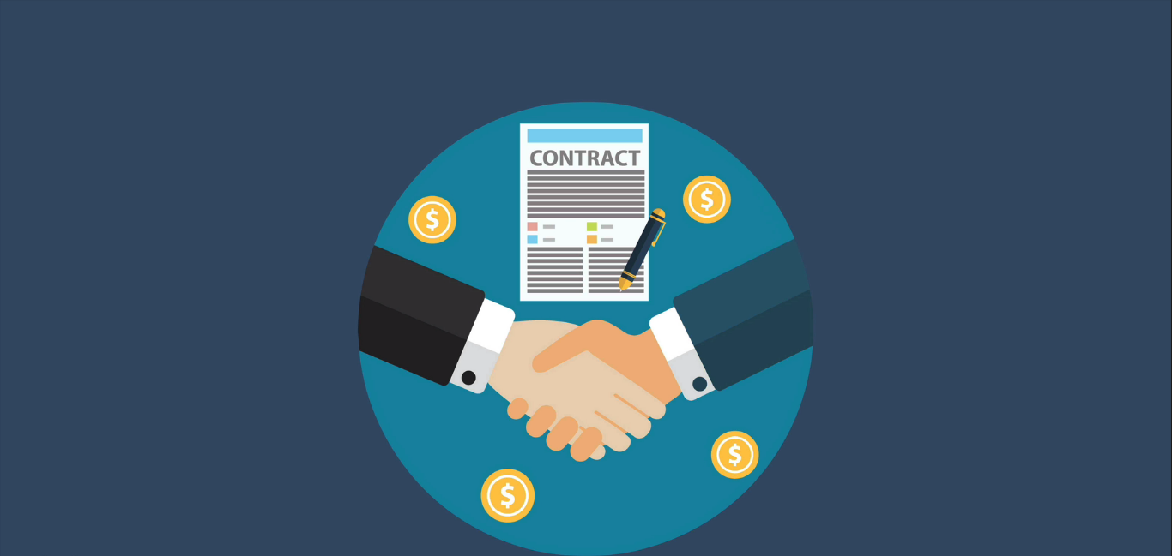
Here some time API is considered as contract
Between the data provider and the developer.

Slide 20
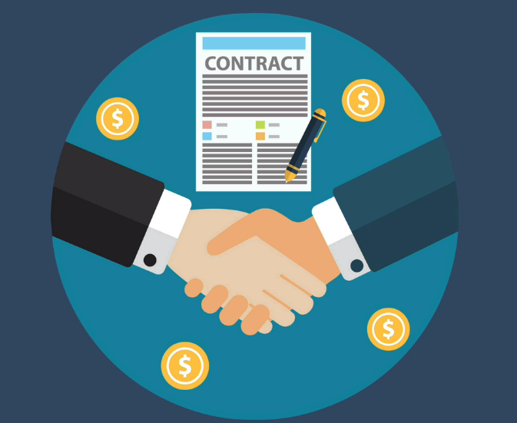

Slide 21
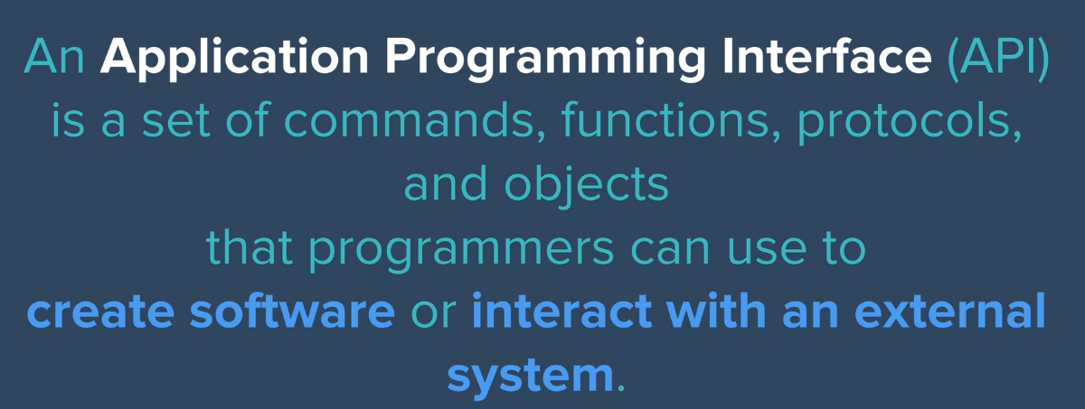
Revisiting definition of API

Slide 22
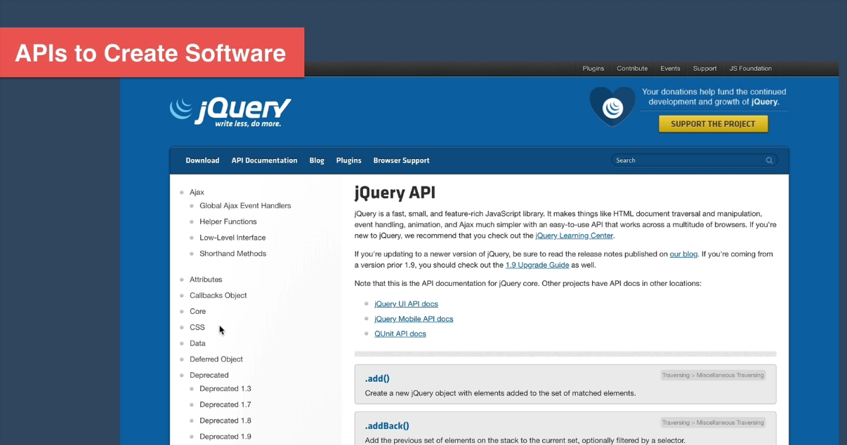
It is an example where API is helping to
Create a software

Slide 23
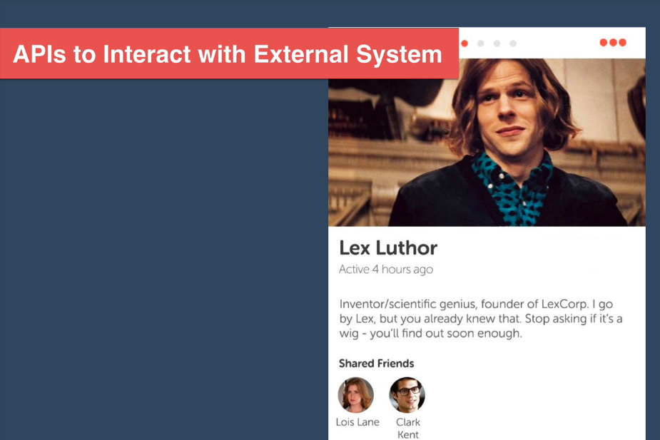
It is an example where API is interacting with External System – Facebook data is displayed at Some Web Application

Slide 24
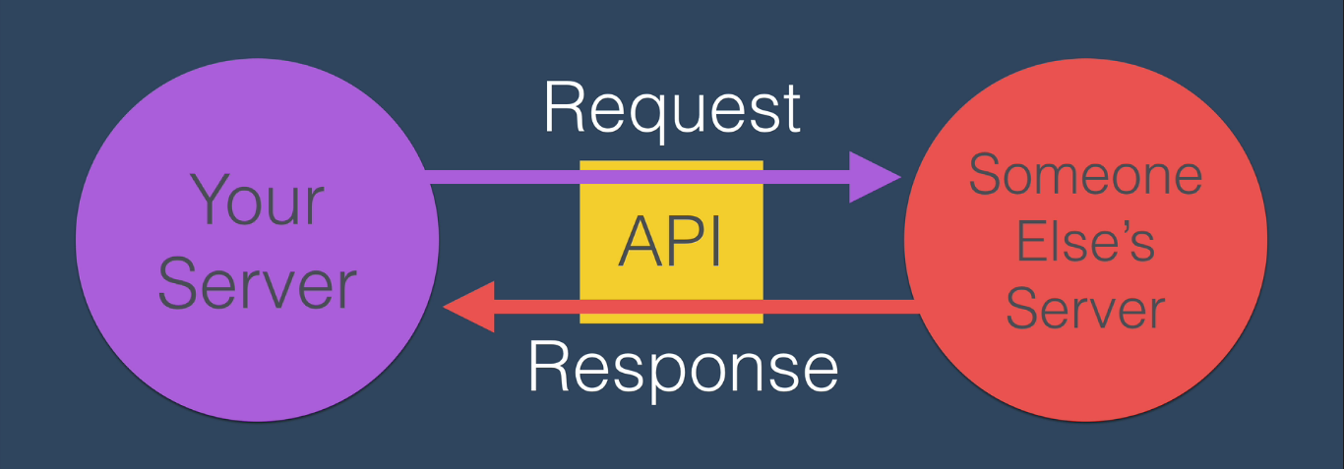
W are going to use their API as a menu of things that we can do to interact with their data.

